Slide 1
Spatial Modeling of
Wildfire Risk
Keith T. Weber, GISP
GIS Director, ISU

Slide 2
Course Description
Learn spatial modeling with ArcGIS using wildfire as a use-case scenario. Students will learn not only how to model wildfire susceptibility, hazard, risk, and conflagration risk, but also how to acquire, prepare, and evaluate source data as well as understand fire ecology and management. This special topics course provides in-depth details of data sources, data architecture, and geoprocessing tools including spatial interpolation, composite indices, and deep learning.

Slide 3
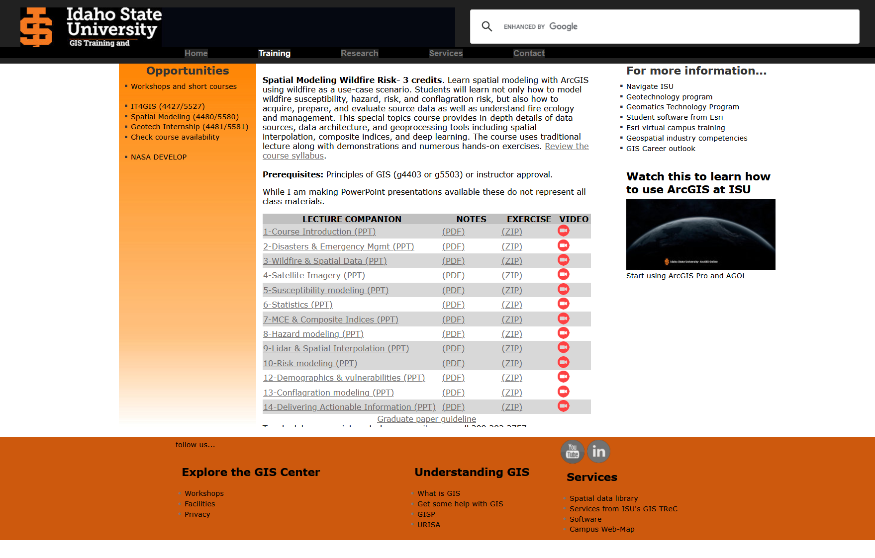
Our Dashboard

Slide 4
Syllabus
Each week will include:
  Announcements, review, and warm up
  Presentation and discussion
  Two-minute write
Homework exercises are typically due the following week
  Deadline to avoid late penalties
  File naming convention
Graduate student projects
Office hours

Slide 5
Structure
Participating in discussions is important to earn classroom points (20%)
  Engagement is critical
Two-minute writes
Debrief summaries

Slide 6

Questions

